Slide 1
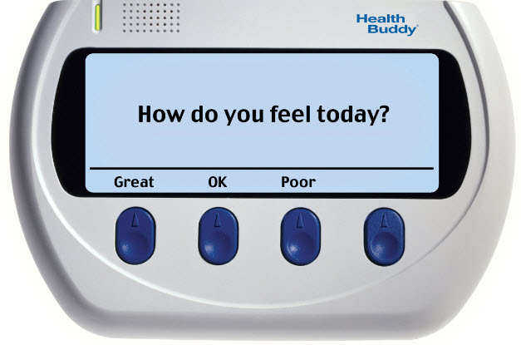
Remote Home/ Patient Monitoring
Bob Marshall, MD MPH MISM FAAFP
DoD Clinical Informatics Fellowship

Slide 2
Learning Objectives
Define remote home/patient monitoring
Review the five steps in the remote patient monitoring process
Provide examples of clinical use
Discuss pros (benefits) and cons of RHM/RPM
Discuss the scholarly literature on the subject
Answer all questions

Slide 3
Introduction/Definition
Remote patient monitoring (RPM) uses digital technologies to collect medical and other forms of health data from individuals in one location and electronically transmit that information securely to health care providers in a different location for assessment and recommendations.
Monitoring programs can collect a wide range of health data from the point of care, such as vital signs, weight, blood pressure, blood sugar, blood oxygen levels, heart rate, and electrocardiograms
This allows patients, such as the elderly, disabled or chronically ill, to live at home while increasing access to care and decreasing healthcare delivery costs
RPM can also serve to reduce the number of hospitalizations, readmissions, and lengths of stay in hospitals

Slide 4
Perspectives on Remote Patient Monitoring
A 2012 eHealth patient survey by the public relations agency Ruder Finn found that 33% of patients want their physicians to have access to remote monitoring technologies
Older patients want these technologies even more: 40% of older patients want access to technology that can alert physicians and other caregivers if they are having a health emergency
For now, establishing—and being paid for—a remote monitoring program remains a challenge, especially for small and solo independent practices

Slide 5
Examples of RPM Technology
Glucose meters for patients with diabetes
Heart rate or blood pressure monitors
Continuous surveillance monitors that can locate patients with conditions like dementia and alert healthcare professionals of an event like a fall
Remote infertility treatment and monitoring
At-home tests that can keep substance abuse patients accountable for and on track with their goals
Caloric intake or diet logging programs

Slide 6
VHA Use of RPM
The VHA has expanded use of RPM beyond common chronic disease applications, to post-traumatic stress disorder, cancer and palliative care
VHA’s findings indicate improvements in a wide range of metrics, including decrease in emergency department visits, hospitalizations, and nursing home admissions
Findings from the VHA Care Coordination/Home Telehealth program show that RPM deployment resulted in significant savings to the organization

Slide 7
Whole System Demonstrator Trial in UK
45% reduction in mortality rates
20% reduction in emergency admissions
15% reduction in A&E visits
14% reduction in elective admissions
14% reduction in bed days

Slide 8
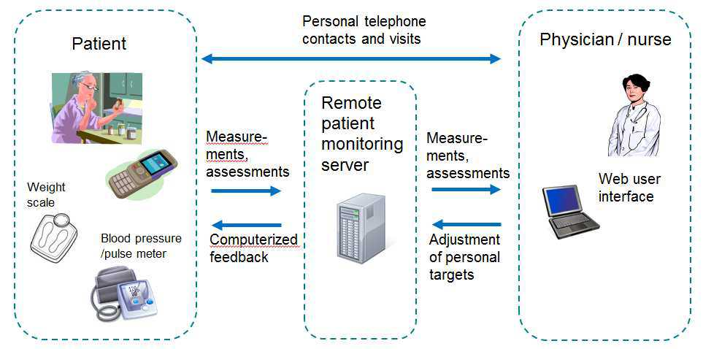

Slide 9
Five Steps to Remote Patient Monitoring: Phase 1 - Collect
Activation
Patient, caregiver, clinician or third-party activates or initiates device for passive or active data collection
Obtaining Data
Activated device passively or actively collects information, which is recorded and stored for viewing and/or delivery
This can done on the device, on a computer attached to the device (Bluetooth, wireless and USB), or sent directly to the patient portal
Packaging Data
Data is packaged in the appropriate format for transmission

Slide 10
Five Steps to Remote Patient Monitoring: Phase 2 - Transmit
Delivery
Data transmitted via Internet, telephone, text message or other electronic method
Receipt
Appropriate provider, caregiver or third-party receives the patient data from the device
This can be either through patient monitoring software, via the patient portal or manually via the above methods
Indicators Programmed
Indicators of thresholds and normal results are programmed into an algorithm or noted manually if reviewed by a clinician

Slide 11
Five Steps to Remote Patient Monitoring: Phase 3 - Evaluate
Data Review
Indicators are used to screen data for areas of concern, either by using an algorithm to compile results or a clinician to tabulate the information
Alert Preparation
Device, intermediary software or healthcare worker prepares the alert for transmission to care team via phone, text, pager or e-mail
Some software may be able to filter and prioritize alerts based on predetermined, algorithmic severity
In acute events, an alert is sent according to structured hierarchy of the patient’s health team

Slide 12
Five Steps to Remote Patient Monitoring: Phase 4 - Notify
Alert Sent
Alert is sent to patient and designated responders, including family, caregiver and emergency technicians who can provide assistance to the patient if needed
For non-urgent alerts, the patient or caregiver (maybe a visiting nurse or home health aide) is provided an alert about what is wrong with the patient’s data/parameters (e.g., excessive weight gain, elevated BP, reduced peak flow, etc)

Slide 13
Five Steps to Remote Patient Monitoring: Phase 5 - Intervene
Treat and Adjust
Clinicians, emergency responders, family and the device intervene in the patient’s activity to provide assistance and adjust treatment
If at home and accessed/served by home health nurses or aides, they can be notified and instructed on the recommended intervention
If enrolled in a care coordination capability via their clinic/PCM, the care coordinator (often a nurse) can provide short term interventions and make f/u appointments
Education
Clinicians teach patient, caregiver and the family about the incident, and how to handle or prevent it in the future

Slide 14
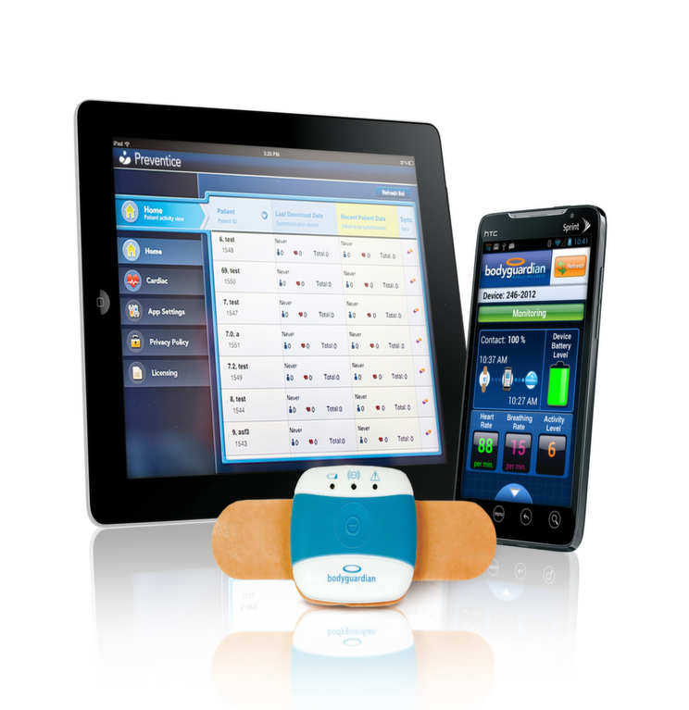
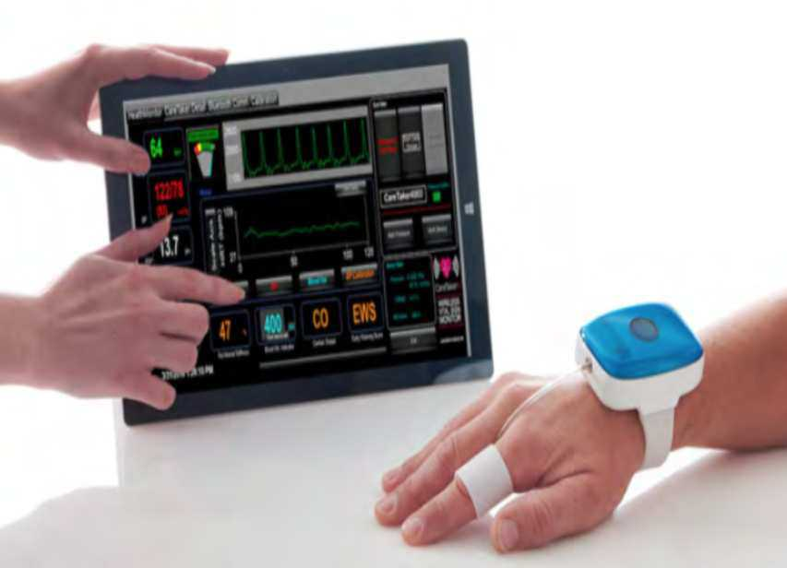

Slide 15
Clinical Example 1 – 2015 Study
“Feasibility and Acute Care Utilization Outcomes of a Post-Acute Transitional Telemonitoring Program for Underserved Chronic Disease Patients"
Investigated acute care utilization outcomes during use of a 90-day transitional telemonitoring program for underserved COPD and heart failure patients
Patients were enrolled in the program between October 2010 and August 2012, and researchers measured rates of emergency department visits and all-cause re-admission after 30, 90, and 180 days
The study found a 50% reduction in 30-day readmission and a 13-19% decrease in 180-day readmission among patients who received the telemonitoring intervention
Ultimately, they concluded that remote patient monitoring has the potential to reduce long-term acute care utilization

Slide 16
Another 2015 Clinical Study
“The Relationship Between Level of Adherence to Automatic Wireless Remote Monitoring and Survival in Pacemaker and Defibrillator Patients”
Examined the relationship between survival and adherence to remote patient monitoring in pacemaker and defibrillator patients
The researchers studied 269,471 patients who received pacemakers, implantable cardioverter-defibrillators, or cardiac resynchronization therapy, noting their weekly use and all-cause survival following implantation
The results showed that those who spent more time using remote monitoring had higher survival rates than those who did not use remote monitoring, providing evidence that increased use of remote monitoring can improve patient outcomes

Slide 17
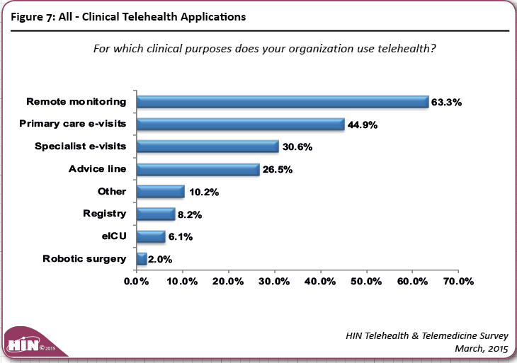

Slide 18
Benefits of RPM for Patients
Improved health outcomes and quality of life
Real-time support and interventions
Extension of care at home after discharge, helping to prevent emergencies and readmissions
Reduced hospital stays
Potentially reduced emergency department visits

Slide 19
Benefits for Care Providers
Support the extension of clinical environments into a patient’s home post-discharge through remote monitoring
Access to increased frequency of patient health data
Ability to continue monitoring patient health, regardless of patient’s location, even when not at home
Support an increased level of accuracy for clinical monitoring readings, particularly readings that would otherwise be provided by the patient themselves via manual entry (with potential for error)
Increase the level of trust and reliance that physicians place in data.
This is particularly important when there are a few outlying readings, which may potentially indicate an underlying problem, but which might be attributed to errors in measurement
Reduced costs from readmissions and reduced hospital stays

Slide 20
Benefits for Payers
Better visibility on patient adherence practices
More accountability from patients and care providers
Reduced costs of care

Slide 21
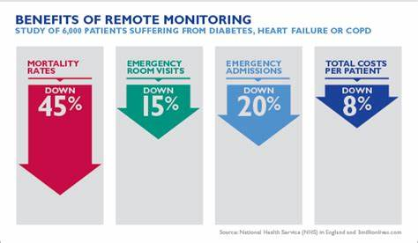

Slide 22
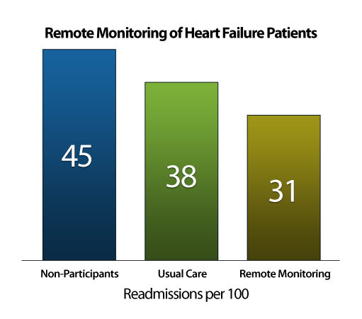

Slide 23
Cons to Remote Patient Monitoring
The cost-saving approach of RPM first requires an investment
Investments in equipment, data transfer, and response to incoming data, all of which can add up
A 2013 report by the Center for Technology and Aging, in Oakland, California cited median first-year expenses of about $1,000 to $2,000 per enrolled patient for technology and personnel
The big hit isn’t usually the cost of devices and applications, as these are plummeting in price and getting easier to use
To make a difference, transmitted data must get to a medical provider in a form that leads to a decision

Slide 24
Challenges to RPM Implementation
RPM is highly dependent on the individual’s motivation to manage their health
Without the patient’s willingness to be an active participant in their care, RPM implementation will likely fail
The shift of accountability associated with RPM brings up liability issues
There are no clear guidelines in respect to whether clinicians have to intervene every time they receive an alert regardless of the urgency

Slide 25
Limitations to RPM 1 of 2
The continuous flow of patient data requires a dedicated team of health care providers to handle the information, which may, in fact, increase the workload
Although technology is introduced with the intent to increase efficiency, it can become a barrier to some healthcare providers that are not technological
Depending on the comorbidities monitored, RPM involves a diverse selection of devices in its implementation
Standardization is required for data exchange and interoperability among multiple components

Slide 26
Limitations to RPM 2 of 2
RPM deployment is highly dependent on an extensive wireless telecommunications infrastructure, which may not be available or feasible in rural areas
Since RPM involves transmission of sensitive patient data across telecommunication networks, information security is a concern
Lack of standardization of RPM nomenclature and definition makes it difficult to differentiate between different forms of patient monitoring involving technology

Slide 27
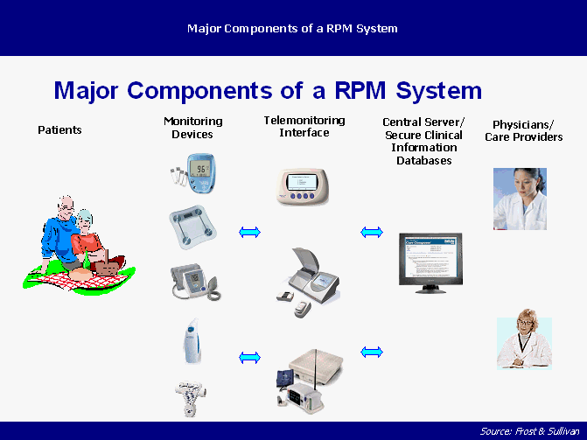

Slide 28
Financial, Operational and Practical Implications 1 of 2
Getting paid
Physicians must be compensated for or somehow recoup their costs for hosting these monitored blood-pressure cuffs, weight scales, body sensors and other devices in patient homes, and to field and make sense of the data they produce
Staffing needs
Someone must be in charge of going through the incoming data in a timely way and be able to either respond directly to, or hand off to the appropriate medical professional, a recognized indication that a patient needs immediate intervention

Slide 29
Financial, Operational and Practical Implications 2 of 2
Filtering important data
The quantity of data these monitors potentially produce on patients can’t be allowed to overwhelm physician workflow and information handling, but pertinent data have to find their way into the office mainstream, usually via the electronic health record.
Legal uncertainty
Questions of medical/legal liability can arise from the availability of data that detect precursors to serious health threats--and the prospect that no one will see the threat and act expeditiously

Slide 30
2019 CMS Codes for RPM
CPT 99453: This code reimburses certain costs associated with initial device set-up and patient education on the use of devices such as blood pressure cuffs, pulse oximeters and even scales
CPT 99454: Allows for the reimbursement of remote monitoring of physiologic parameter(s). For example, weight, blood pressure, pulse oximetry and respiratory flow rate
CPT 99457: This code covers remote physiologic monitoring treatment management services

Slide 31
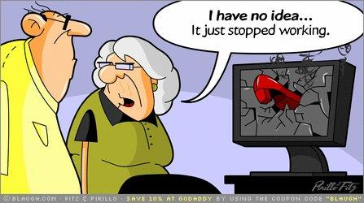
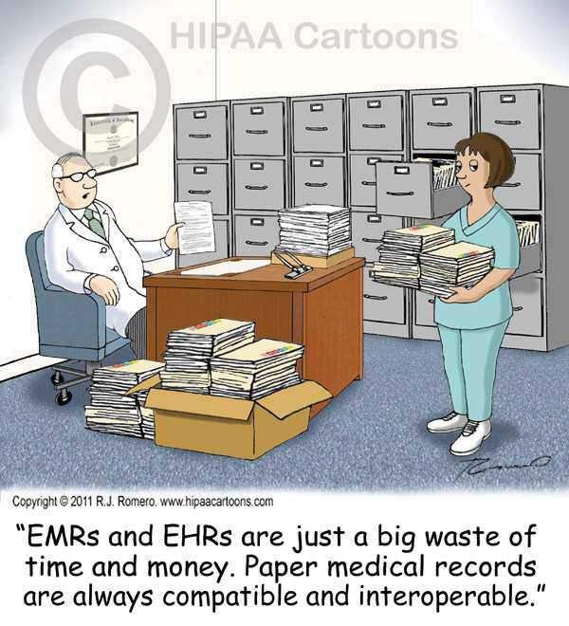

Slide 32
The @Home Study 1 of 2
A year-long remote monitoring program for patients with heart failure saved more than $8,000 per patient and reduced hospitalizations by more than 30 percent
The @Home study, conducted by Pennsylvania-based Capital Blue Cross and mHealth technology company Geneia, compared Blue Cross members equipped with Medtronic’s ZephyrLIFE home monitoring platform to a control group of non-monitored HF patients
The resulting reductions in costs and hospitalizations, officials said, shows that a typical one-million-member health plan could save more than $1 million a year through an RP
The remote patient monitoring platform reduced the progression of the disease, with participants seeing a 2 percent progression compared to more than 30 percent in the control group.

Slide 33
The @Home Study 2 of 2
In addition, participants saw a new 45 percent reduction in acute hospital admissions, and a net 34 percent reduction in admissions directly attributed to HF
Financially, program participants reduced their healthcare expenses by an average of $8,375 per patient over the course of the year
And the program reportedly scored 96 percent in patient satisfaction
There was one off-setting cost to the RPM project – a 7 percent increase in ED visits, likely tied to the program’s improved ability to pick up on health issues that an unmonitored patient and his/her caregivers might miss

Slide 34
Banner Health RPM Program 1 of 2
The Arizona-based, 28-hospital health system’s Intensive Ambulatory Care (AIC) program, launched as a pilot in 2013, treats a patient population that typically generates 50 percent of a hospital’s overall spend
Using a remote monitoring platform from Philips that coordinates care for those patients in their own homes, hospital officials say they’ve reduced care costs and improved outcomes
Reduced overall costs of care by 34.5 percent, measured through reductions in hospitalizations, days in the hospital, professional services and outpatient costs
Reduced hospitalizations by 49.5 percent, from a monthly rate of 10.9 hospitalizations per 100 patients before the program to a rate of 5.5 acute and long-term hospitalizations after enrollment

Slide 35
Banner Health RPM Program 2 of 2
Reduced the number of days in hospital by 50 percent, from a monthly average of 60 days per 100 patients before enrollment to 30 days per 100 patients after enrollment
Reduced the 30-day readmission rate by 75 percent, from 20 percent prior to enrollment to 5 percent after enrollment

Slide 36
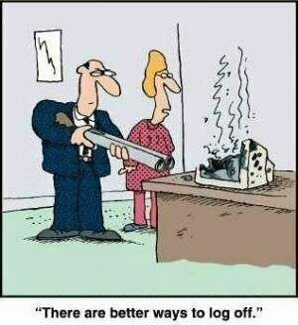
Questions??

